Slide 1
Atom – Improving focus and attention Brain-Computer Interfacing using Electroencephalography
Supervisor: Dr. Yasir Faheem
Kinza Arshad – FA16-BCS-108
Muhammad Faizan Badar – FA16-BCS-054
Notes:
-Brain-Computer Interfacing is another utility for the task of human computer interaction
-Provides a user a way of interaction with the computer using the brain

Slide 2










Abstract Componentization
Electroencephalography
Machine Learning
+
Human Interface
Brain-Computer Interface
Electrodes
Hardware Interface
EEG Headset
Notes:
-The genesis/birth of Brain-Computer Interfacing was from EEG

Slide 3
Framework of Research
Human-Computer Interaction [1]
User Customization
Brain–Computer interfaces
Emotions and human-computer interaction
Knowledge-driven human–computer interaction
Augmented Reality
Social Computing
Embedded Computation
Notes:
-A sense of belonging in the framework of research; Our project lies amongst other major research disciplines
-Making our field from an undermined underdog into an people’s champion is a safe bet

Slide 4
Problem Resolution leveraging EEG-based BCI
Problem Statement
Consequences of the coming of the millennial age [2][3][4][5]:
Shorter attention spans
Dopamine addiction
Short-lived focus
ADHD
Neurophysiological problems and consequent effects
Problem Solution
Cognitive training through:
Induced Self-awareness
Reiterated Reinforcement
Main Objective: Bring the aspect of Cognitive Training to commercial products and provide a research standpoint along the way

Slide 5
Solution Streams
Entertainment Incentivized Training
An environment with multiple games and mini-games interactable and playable employing the components of previously mentioned BCI
Specialized Control Training
An environment in which user enters for self-developmental purposes and self-improvement pertaining more to Cognitive Training
Continuous Background Monitoring
Induced Self-awareness
Reiterated Reinforcement

Slide 6
Summarizing Development Modules
Attention monitoring book reader
User profiling and access management
Machine Learning on waves
Attribute Extraction
1
Account Handling
3
Specialized Control Training
5
EEG Feature Extraction
2
User Analytics and Statistics
4
Entertainment Incentivized Training
6
Database Handling
Progress and stats reporting
Database storage and management
Games and mini-games

Slide 7
Technologies
Python
Java
Firebase
Programming Language - 3.7
Programming language – ver7
For game development scripting
C#
For machine learning and data diagnostics
Programming Language – jdk8
App and interface design for android
Non-relational database for data storage

Slide 8
Tools
Android Studio
Unity
IDE & Studio
Application development and design
IDE
Emotiv
Headset
EEG headset to be used for signal acquisition
Game development and design
Colaboratory
Cloud Execution
To develop python scripts and machine learning models

Slide 9

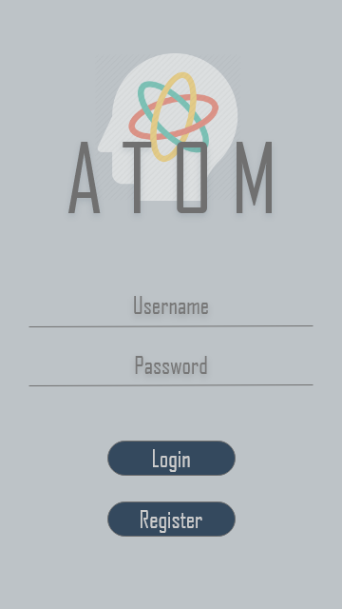
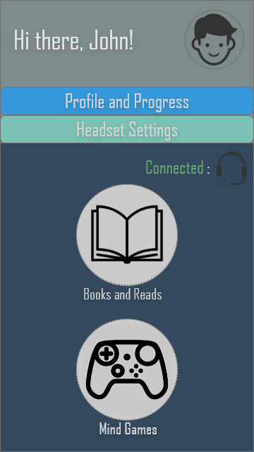
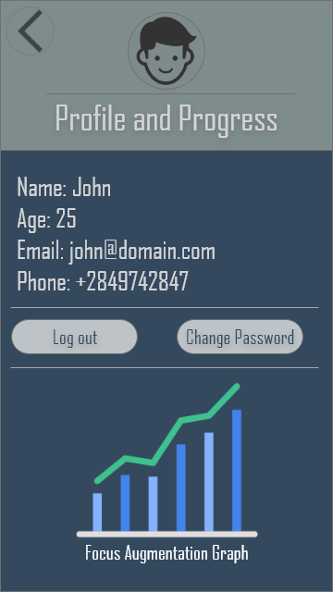
Mockups on the interface

Slide 10

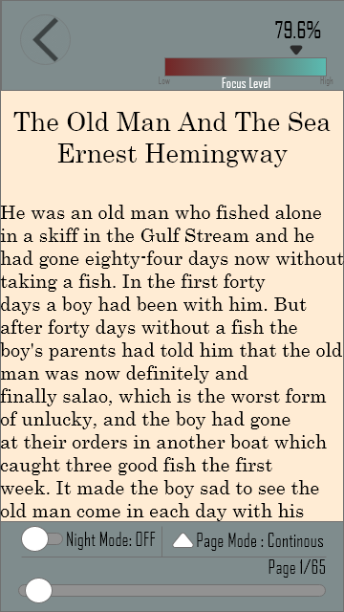
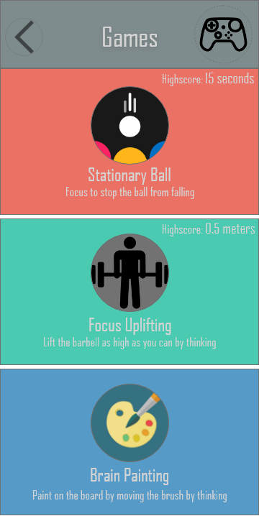
Mockups on the interface

Slide 11
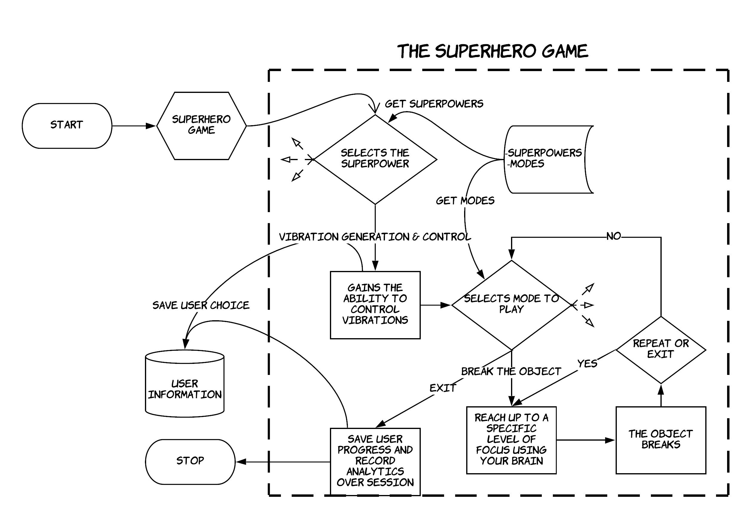
Visualizing an example

Slide 12


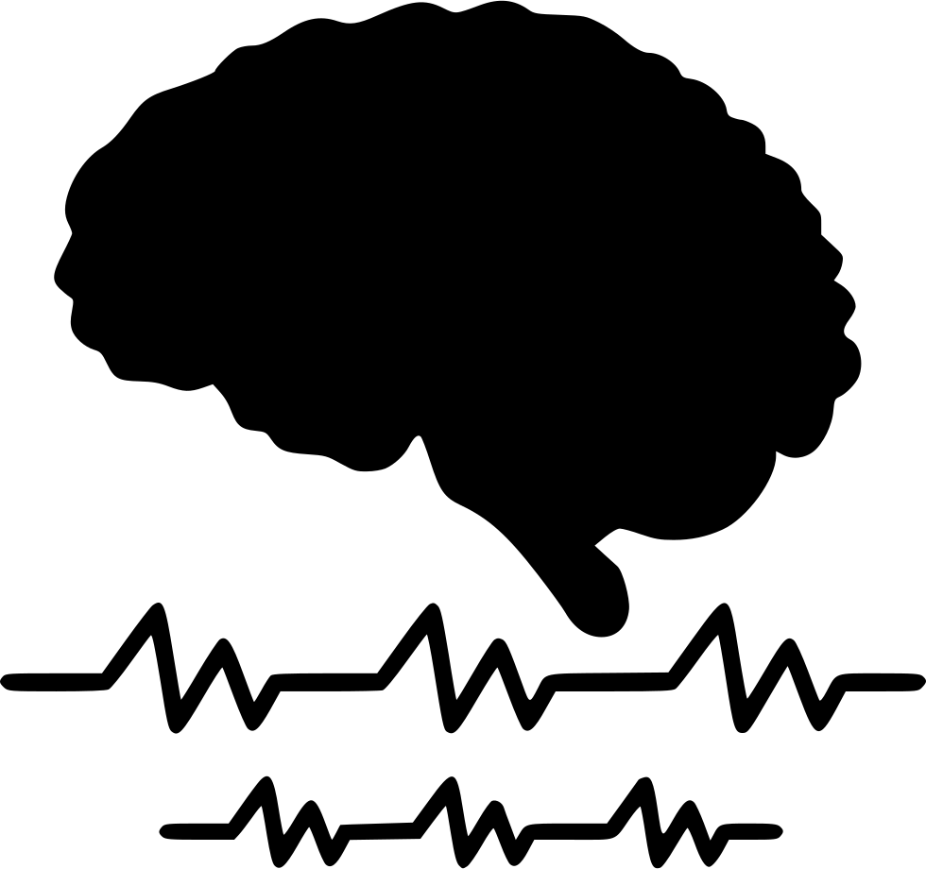
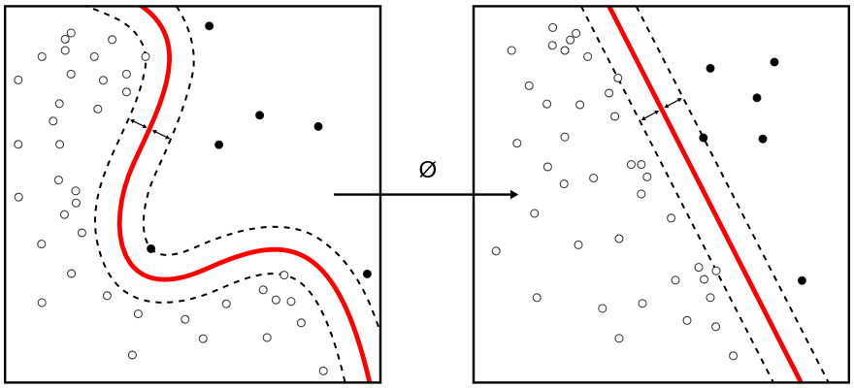
Our Learning
Machine Learning
EEG Analysis
Neurocomputation and BCI in general
Game Development
Artificial Intelligence

Slide 13
Transitioning into Commercialization
Social Networking VS Brain Computer Interaction
Under the same umbrella of the framework of research, but different with respect to awareness. There is an inherited exclusivity and ease of interactability.
The untapped primal sense of humans
Unlike the other senses i.e. touch, vision, hearing; brain responding and interacting is a great rarity
Benefit of the development methodology chosen
Games hold the ability to captivate the minds of millennials, and can cause consumer crowd sourced identification of the application for other types of consumers
Notes:
A smarter young generation
Millenials to professionals

Slide 14
References
Current Research, Human Computer Interaction – Wikipedia
Young Adult Outcome of Hyperactive Children: Adaptive Functioning in Major Life Activities – Barkley et al. ’06
Cognitive neuroscience of attention deficit hyperactivity disorder and hyperkinetic disorder – Swanson et al. ’98
Neuropsychopathological comorbidities in learning disorders – Margari et al. ’13
Textbook of Pediatric Neuropsychiatry – American Psychiatric Press ‘98

